Slide 1



Critical Incident Reporting
Personal Care Services Training 2019
Presented by:
1

Slide 2
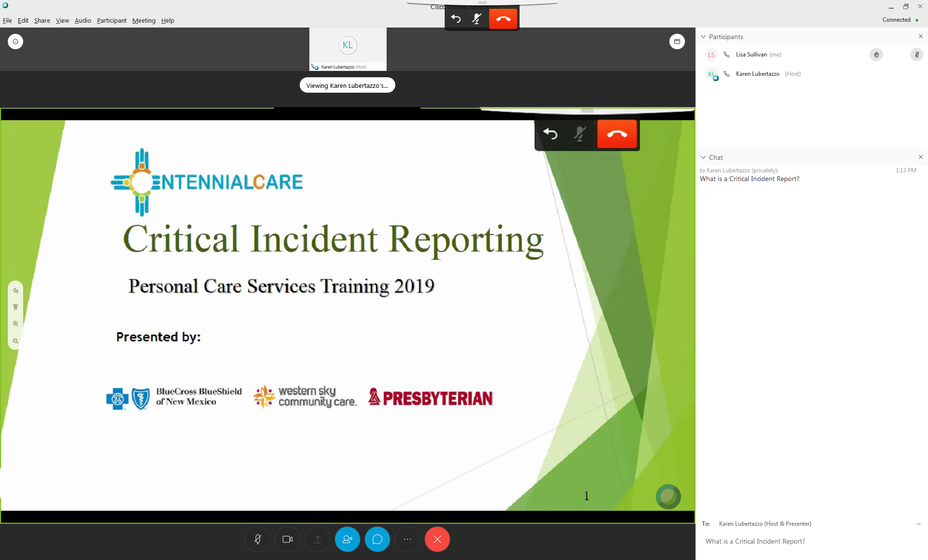
Audio Connection
Raise Hand Function
Mute
Presentation Screen
Show Participants
Chat Function
Select presenter name from the drop down.
Type message and press “Enter” on your keyboard.
2

Slide 3
Welcome Comments
We appreciate you taking time out of your busy schedules to attend today’s training.
We are here to provide training and offer our assistance when you have questions about Critical Incident Reporting.
This training is a collaboration of HSD/MAD Quality Bureau staff and the Centennial Care MCOs.
3

Slide 4

Training Responsibilities
Centennial Care MCOs have the responsibility to train providers of Long-Term Care (LTC) and Home & Community Based Services (HCBS) on the purpose and procedures for reporting Critical Incidents.
In turn, agencies have the responsibility to train all staff on the purpose and procedures for reporting Critical Incidents.
4

Slide 5
Basic Information
Staff must receive initial and ongoing training to be competent to respond to, report and document incidents in a timely and accurate manner.
Recipients, legal representatives, and guardians must be made aware of and have available incident reporting processes.
Each agency is responsible to train all staff who work with Centennial Care members on the Critical Incident reporting requirements.
All adults and children receiving Centennial Care services should be able to enjoy a quality of life that is free of abuse, neglect and exploitation.
5

Slide 6
Acronyms
ANE: Abuse, Neglect and Exploitation
APS: Adult Protective Services
BHSD: Behavioral Health Services Division
CIR: Critical Incident Report
COE: Category of Eligibility (Located in the Medicaid
Portal and listed on the HSD Portal)
CPS: Child Protective Services
ED/ER: Emergency Department or
Emergency Room
HSD: Human Services Division
MAD: Medicaid Assistance Division
MCO: Managed Care Organization
NFLOC: Nursing Facility Level of Care
QB: Quality Bureau at MAD
6

Slide 7
Health Insurance Portability and Accountability Act (HIPAA)
Protecting the privacy of Members’ personal health information is a core responsibility that NM Human Services Department (HSD) takes very seriously. HSD is committed to complying with all federal and state laws regarding the privacy and security of Members’ protected health information (PHI) and electronic protected health information (ePHI) as outlined in the Health Insurance Portability and Accountability Act of 1996 (HIPAA) Privacy Rules and Security Rule.
All end users of the Critical Incident Reporting database are required to comply with the federal and state information security and privacy regulations as directed through the HSD contract with the Managed Care Organizations (MCOs). The MCOs and their subcontractors, consultants, representatives, providers and agents must comply with all applicable statutes, rules and regulations regarding information security. HSD expects that agencies contracted as Centennial Care providers will comply with the federal and state information security regulations as outlined in their contracts with the MCOs. New Mexico State employees accessing the CIR database will comply with federal and state information security regulations in accordance with the New Mexico State employee required HIPAA training.
7

Slide 8

Critical Incident
A Critical Incident is an occurrence that represents actual or potential serious harm to the well-being of a member or others.
Any individual who, in good faith, reports an incident or makes an allegation of abuse, neglect or exploitation will be free from any form of retaliation.
Quality starts with those who work most closely with persons receiving services.
8

Slide 9
Why A Critical Incident Report Matters
It’s a communication tool.
It helps to ensure that everyone assisting the member has the most current information.
It helps to address potential gaps in the member’s care.
It expedites actions to help meet the member’s needs.
9
Notes:
Reporting incidents allows providers, service delivery agencies and Managed Care Organizations (MCOs) to address concerns quickly for health and safety.
Incidents are reported to improve service quality by identifying issues or areas of concern.
An incident must be reported before it can be investigated.

Slide 10




Statutes and Regulations
Adult Protective Services (APS) - NMSA 1978, Section 27-7-30
  http://law.justia.com/codes/new-mexico/2017/chapter-27/article-7/section-27-7-30/
Children, Youth and Families Department (CYFD) –also known as Children Protective Services (CPS)
https://law.justia.com/codes/new-mexico/2017/chapter-32a/article-4/section-32a-4-3/
HSD –Critical Incident Reporting
http://www.hsd.state.nm.us/providers/critical-incident-reporting.aspx
Department of Health - NMAC 7.1.13 and 7.1.14
http://164.64.110.134/parts/title07/07.001.0013.html
  http://164.64.110.134/parts/title07/07.001.0014.html
10

Slide 11
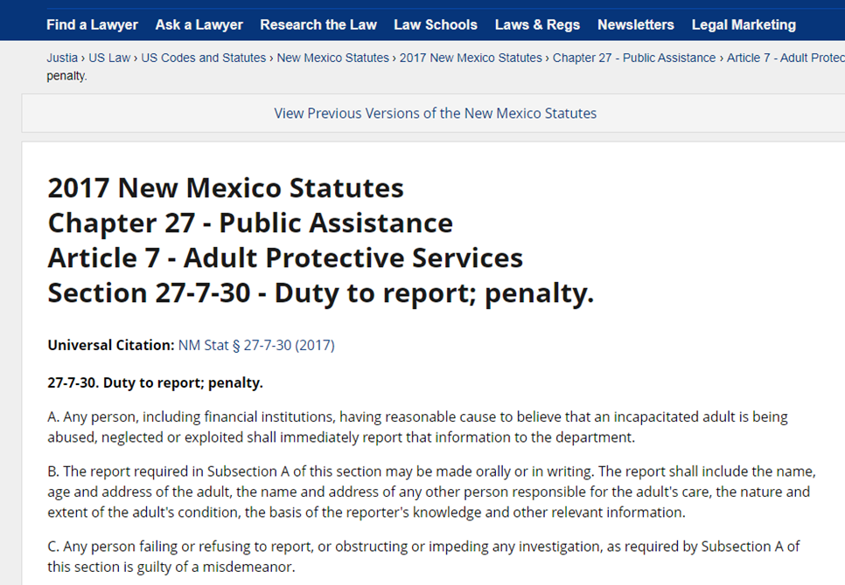
APS Regulations
Adult Protective Service (APS): Telephone: (866) 654-3219
Fax: (855) 414-4885
11

Slide 12
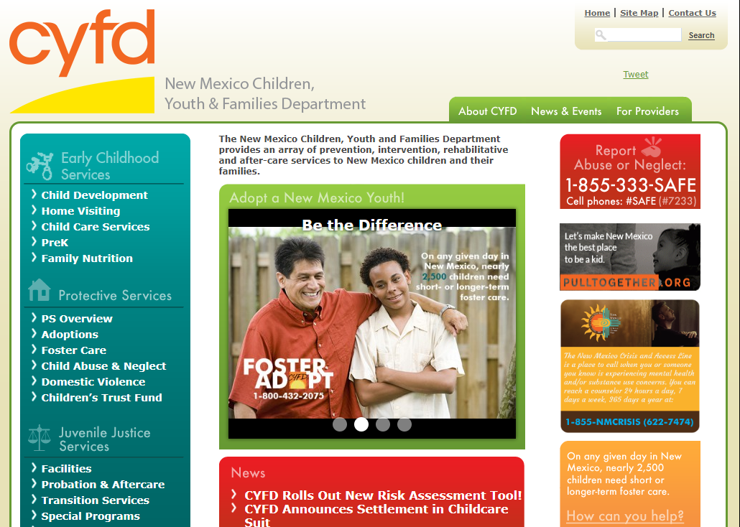
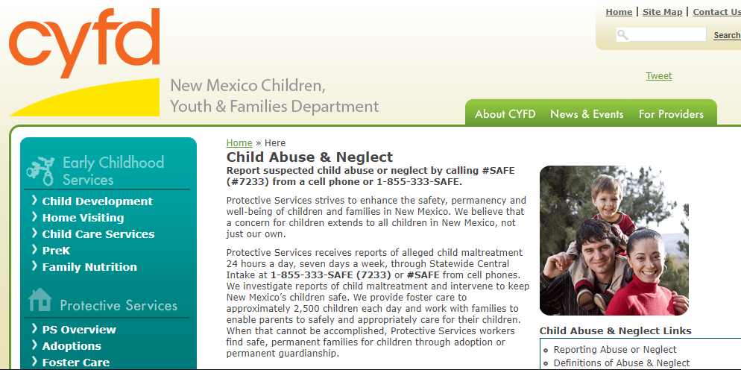
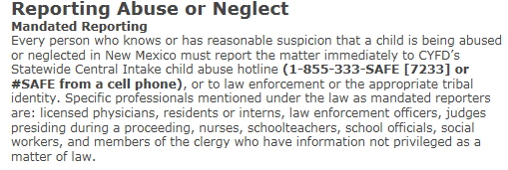
CYFD/CPS Regulations
Child Protective Service (CPS): Telephone: (855) 333-7233 or Fax: (505) 841-6691
12

Slide 13
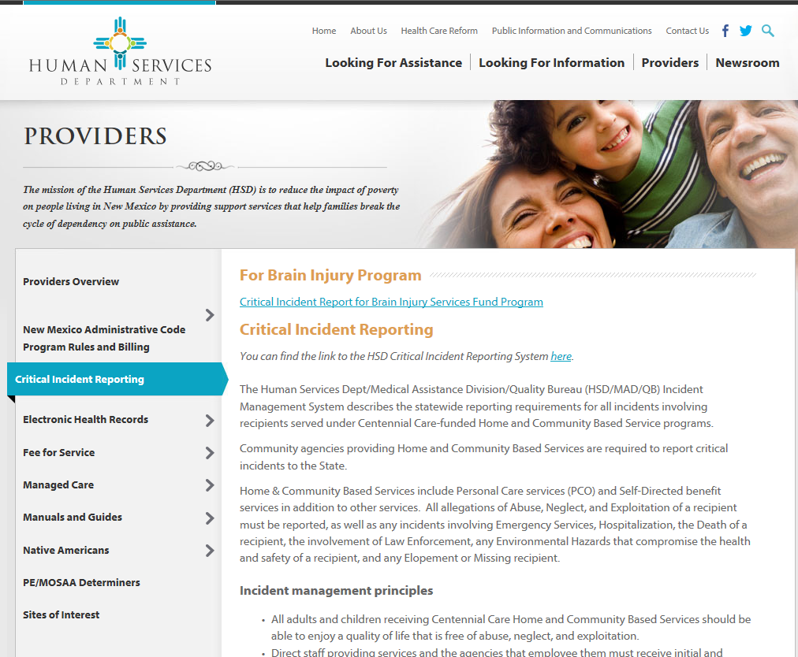
HSD Requirements
13

Slide 14
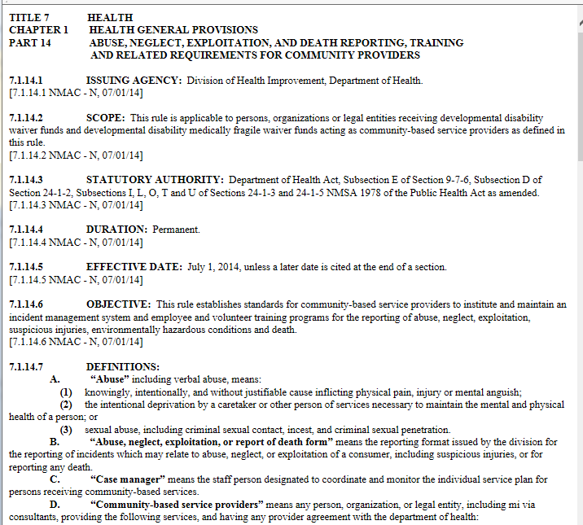
DOH Regulations
7.1.14.8 INCIDENT MANAGEMENT SYSTEM REPORTING REQUIREMENTS FOR COMMUNITY-BASED SERVICE PROVIDERS: the community-based service provider shall also report the incident of abuse, neglect, exploitation, suspicious injury, or death utilizing the division’s abuse, neglect, and exploitation or report of death form consistent with the requirements of the division’s abuse, neglect, and exploitation reporting guide. The community-based service provider shall ensure all abuse, neglect, exploitation or death reports describing the alleged incident are completed on the division’s abuse, neglect, and exploitation or report of death form and received by the division within 24 hours of the verbal report.
14

Slide 15
Reporting Requirements
The State of New Mexico Human Services Department (HSD) requires that all Centennial Care contracted providers, practitioners, caregivers and subcontractors report, respond and cooperate by submitting Critical Incidents for the following populations:
Centennial Care Members receiving Behavioral Health Services
Centennial Care Members receiving Long-Term Care Services
Centennial Care Members receiving certain Medicaid-funded Home and Community Based Service programs
15

Slide 16

Questions & Discussion
16

Slide 17
Reportable Incidents
Abuse
Neglect
Exploitation
Deaths (Expected and Unexpected)
Emergency Services
Law Enforcement
Environmental Hazards
Elopement/Missing
17
Notes:
The Agency and the Managed Care Organizations are responsible for reporting a Critical Incident within 24 hours of knowledge.

Slide 18
Categories of Eligibility
NFLOC = Nursing Facility Level of Care
18

Slide 19
Rule of Two
Do I have a reportable incident?
Do I have a reportable COE?
Reminder: Refer to NM Medicaid Portal to validate the member’s current COE.
19
Notes:
Do I have a reportable incident?
If Yes – go to next question.
If No – you do not report the incident using the HSD Portal
Do I have a reportable COE?
If Yes – complete a CIR using the HSD Portal.
If No – you do not need to file a CIR using the HSD Portal. However, you should thoroughly document the incident, possibly file with APS or CYFD per statutes, and communicate with the Member’s MCO Care Coordinator.

Slide 20
Abuse
Abuse is the willful infliction of injury, unreasonable confinement, intimidation, or punishment with resulting physical harm, pain or mental anguish.
Self-Abuse
Self-Abuse is the abuse of one’s self or abilities.
20
Notes:
Abuse Examples:
Abuse can be inflicted upon the member:
The Member is threatened with being homeless or placed in a nursing home.
The Member is pushed or roughly handled while receiving care.
The Member is sexually assaulted.
The Member is made to do without food, water, or bathroom access as punishment.
Abuse can also be from the member towards others:
Sexually harasses caregivers.
Threatens caregivers or their families either verbally or physically.
Consistently uses racial or ethnic slurs when talking to caregivers.
Self- Abuse Examples:
The Member attempts suicide.
which Includes cutting self, banging head repeatedly or intentionally stepping into traffic.

Slide 21
Neglect
Neglect is the failure to provide goods and services necessary to avoid physical harm, mental anguish, or mental illness.
Self-Neglect
Self-Neglect is living in a way that puts the member’s health, safety or well-being at risk.
21
Notes:
Neglect Examples:
Agency fails to provide services that have been authorized.
Staff show up but do not do assigned tasks.
Family or others who have promised support:
Do not pay the bills.
Do not purchase sufficient food and supplies.
Do not arrange or transport to needed medical care.
Do not provide support as agreed in the personalized service plan for the Member (staying overnight, preparing meals, etc.).
Self-Neglect Examples:
The Member is doubling up on pain medication and will not see the doctor.
The Member’s alcohol consumption results in frequent Emergency Room (ER) visits.
Does not eat enough to stay well or “forgets” to eat.
Refuses to bathe or change clothes.
Forgets, refuses or abuses, prescription medications.
No heat or electricity because bills are not paid.
Shoplifts.
Consistently refuses to allow services to be delivered.

Slide 22
Exploitation
Exploitation is the deliberate misplacement, misuse or wrongful temporary or permanent, use of a member’s belongings or money without the member’s consent.
Reports of alleged fraud may also be considered as exploitation.
22
Notes:
Examples:
Caregiver or others use member’s ATM/debit card for their own purchases or borrows money and does or does not pay it back.
People move into the home uninvited and/or without paying for rent or utilities.
Caregiver convinces member to sign timesheet for hours not worked.
Caregivers or others are taking the member’s property or the member’s medications are frequently missing.
Member is encouraged or pressured into providing sexual services with or without pay.

Slide 23
Fraud
Fraud is the misuse of Centennial Care funds.
All cases of fraud are “alleged” until investigated and proven otherwise.
Any person who reports alleged fraud in good faith, will be free from any form of retaliation.
23
Notes:
Examples:
The member and the caregiver agree to sign off on timesheets that do not represent time worked.
The caregiver has the member sign timesheets ahead of time and turns them in including time not worked.
Billing is submitted when member is out of town or in the hospital.
Member is selling Centennial Care goods (Depends, DME or medications).
Caregiver turns in timesheets for delivery of services to more than one member for the same time/date.
Member in hospital or incarcerated or out of town.

Slide 24

How to Report Fraud
Follow the Critical Incident reporting process for all cases of Abuse, Neglect and Exploitation.
When prompted “Does this incident involve alleged fraud?” reply YES.
Comply with any requests for information from the Member’s MCO regarding the alleged fraud.
The MCO will review, investigate and report the results of investigations to the state.
24

Slide 25
Reporting Deaths
The HSD Portal website offers the following choices when filing a Critical Incident to report a death:
Natural or Expected
Unexpected
Homicide
Suicide
25
Notes:
Natural or Expected Death is a death caused by a long-term illness, a chronic medical condition, or other natural/expected conditions such as advanced age.
Member’s death is attributed to their terminal condition.
Member is of advanced age (90+), and the cause of death is related to disease process.
Death occurred in a facility while member was in treatment for disease/condition.
Member is under Hospice care at the time of death:
If the member is on Hospice care the agency will follow the Hospice plan of care and will not file neglect for refusing food, medications etc.
If a member dies while in Hospice care, and the death is related to the Hospice diagnosis, the death is considered natural/expected.
Unexpected Death is a death caused by an accident or an unknown or unanticipated cause.
Accident
Death unlikely to be attributed to diagnosis/condition.
The caregiver enters the home and finds the member dead on the floor or in bed.
Homicide is a death caused by the killing of one person by another person.
Suicide is a death caused by intentionally killing oneself.

Slide 26
Deaths Reported to APS or CPS
Deaths suspected of being related to abuse or neglect must be reported immediately to APS or CPS.
Deaths that are the result of natural causes and/or are expected do not need to be reported to APS or CPS.
26
Notes:
To emphasize, deaths that are a result of natural causes and/or are expected DO NOT need to be reported to APS/CPS.

Slide 27

Emergency Services
Emergency Services means covered services furnished by a qualified provider needed to evaluate or stabilize an emergency medical condition.
Emergency Services are the provision of medical care to a member that was not planned or anticipated.
Emergency Services are services that would not routinely be provided by a primary care physician.
Emergency Services are provided in times of crisis.
27
Notes:
REMINDER: Specify in the narrative if Emergency Medical Services (911), Law Enforcement, Fire Department or Emergency Room visit were utilized.
Reportable Examples:
911 is called.
The member gets sick and the caregiver takes them to the ER.
The member goes to the ER and then leaves before being seen or treated by medical staff.
The ER releases the member without providing any treatment.
Non-Reportable Examples:
The member is admitted to the hospital for a scheduled treatment or observation.
An ambulance is used for transportation for either a scheduled physician visit or to the hospital for a scheduled procedure.
An “unplanned event” or “taken by ambulance” is not sufficient information to assume use of emergency services.

Slide 28
Law Enforcement
Law Enforcement involvement is an incident that prevents the member from receiving services or directly affects the member’s health and safety.
28
Notes:
Examples:
Police are called to the member’s home.
The member is arrested and/or incarcerated, picked up for a bench warrant or for a parole violation.
The police are called to do a “well check”.
The member is detained in Protective Custody.
The member is transported by police to a hospital or mental health facility, voluntarily or involuntarily.

Slide 29

Law Enforcement & Caregivers
Law Enforcement involvement for a caregiver is reportable when:
The caregiver has harmed or robbed the member.
The caregiver being detained or incarcerated
results in services not being delivered to the member.
The caregiver is also the natural support and is
not available to provide health and safety supports.
It seriously impacts the delivery of services to the
member.
29

Slide 30
Environmental Hazard
Environmental Hazard is an unsafe condition that creates an immediate threat to the life or health of a member.
30
Notes:
Reportable Examples:
Lack of repairs that create hazards:
Roofs that leak or broken windows & doors.
Utilities previously in place have been “shut off.”
Hoarding, foul smells, piles of garbage, or clutter that impedes normal movement to bathrooms or exits.
Animals that are out of control in the home and are threatening services or creating more waste than can be cleaned timely
A fire or flood has created a hazard in the home.
Blatant illegal drug use or visible evidence of the manufacture or sale of drugs.
Guns that are not secured and/or are brandished by the member or others in the home.
Family members or others in the home threaten, frighten or harm caregivers or others who are providing services.
Non-Reportable Examples:
The home is heated with wood and has a functioning stove and ventilation.
The home does not have running water and the home has systems to provide safe potable water for use.
Clutter is contained and does not impede function of the home or safe passage of the individual and caregiver.

Slide 31
Missing
Elopement is when the member leaves without permission or alerting others, or runs away from a facility.
Missing is when the member’s absence is unaccounted for or cannot be explained for more than 24 hours.
Wandering is when the member leaves without intent to stay gone or may be lost or unaware of their surroundings.
31
Notes:
Note: “Missing” is not the same as “unable to contact” the member.
Unable to contact is non reportable if the following guidelines apply:
Initial contact with the member has not been made.
Services with the member have not begun.
Services have begun with the member however, communication or interaction is a challenge.

Slide 32

Questions & Discussion
32

Slide 33
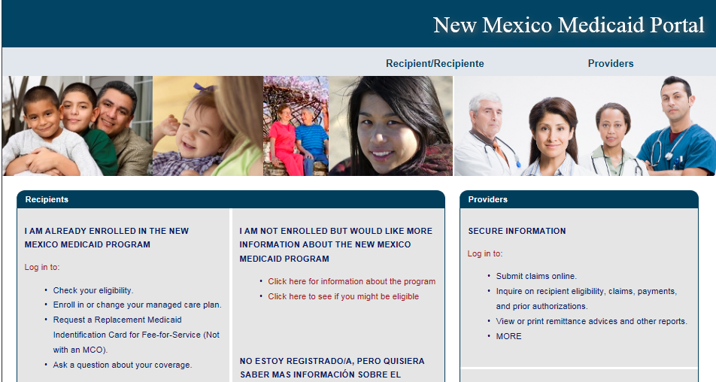
NM Medicaid Portal
33

Slide 34
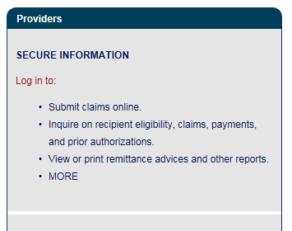
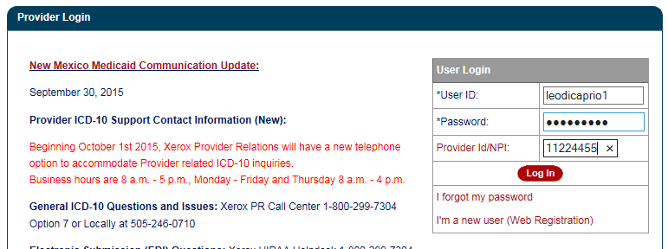
Log In
Go to web site: https://nmmedicaid.portal.conduent.com/static/index.htm
Under Providers, click on link Log in to:
At the User Login section, enter the following:
  User ID: <enter your ID>
  Password: <enter your password>
  Provider Id/NPI: <enter the ID provided by State of NM>
Select Log In button.
34

Slide 35
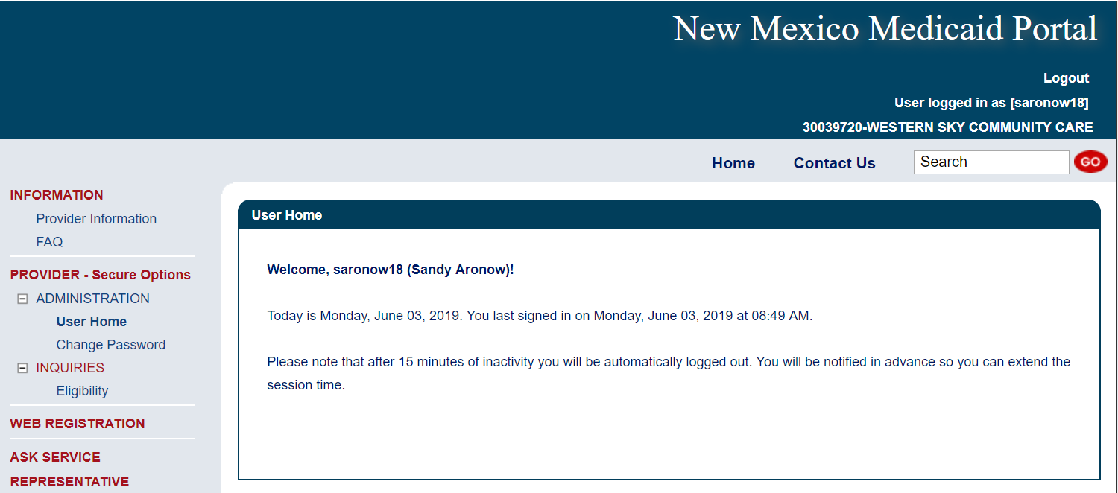
Member Eligibility
Log in as instructed on previous slide.
To start the Member search, select the plus icon next to INQUIRIES.
Select Eligibility.
35

Slide 36
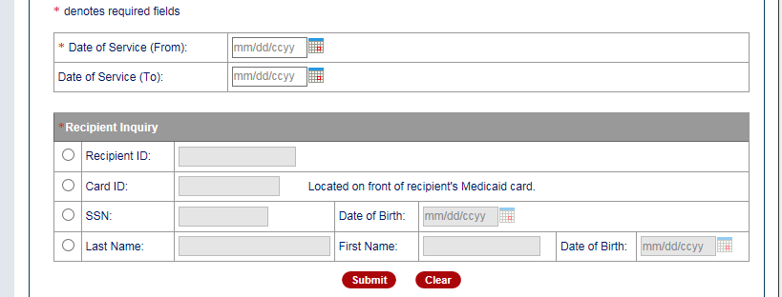
Member Eligibility
Enter the Date of Service (use the Date of Incident).
There are four options to locate a Member under Recipient Inquiry:
      Recipient ID
      Card ID
      SSN & DOB
      Last Name, First Name & DOB
Select a radio button and enter the criteria in the grey box.
Select Submit button.
36

Slide 37
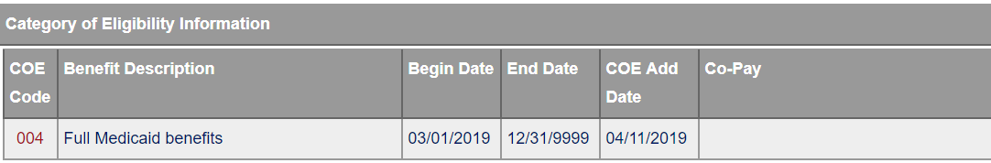
Verify COE
To verify COE, scroll down the screen to section “Category of Eligibility Information”:
Refer to the codes listed under COE Code.
Look at the “Begin Date” and “End Date” to confirm the date of incident falls within that same date period (the COE listed must be current for the date of incident).
37

Slide 38
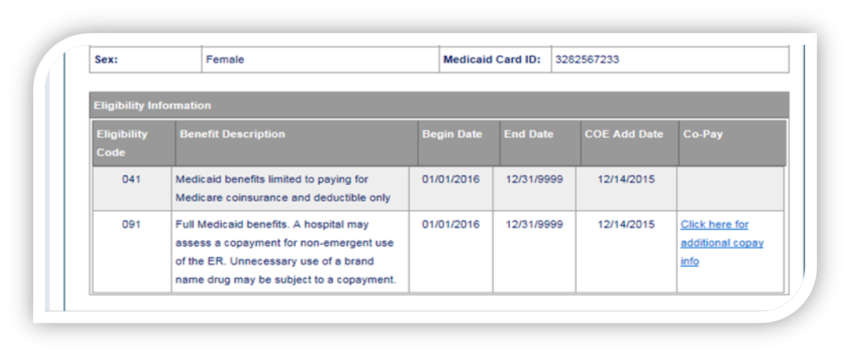
Verify COE
When two COEs are listed and both COEs are accepted on the HSD CIR Portal – refer to the Date of Incident and use (input) the COE listed with most recent date in the COE Add Date field.
  What if the COE Add Date is the same but the COE is different? - use (input) the Eligibility Code (COE) listed first.
  What if two COEs are listed and one is accepted on the HSD CIR portal and one is not – use (input) the COE that is acceptable on the HSD CIR Portal.
  What if the Member is eligible for two or more COEs on the Date of Incident and neither COE is accepted on the HSD CIR Portal? Contact the Member’s MCO.
COE
38

Slide 39
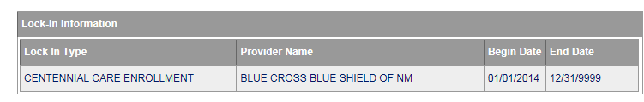
Verify MCO
Once you find the Member and enter the service date range, scroll down to section (Lock-In) Information.
The MCO is listed under Provider Name (in this example, the MCO is BCBSNM).
Look at the “Begin Date” and “End Date” to validate the Date of Incident falls within that same date period.
MCO
39
Notes:
Note: More than one MCO could be listed as the member may have termed with one MCO and joined another.

Slide 40
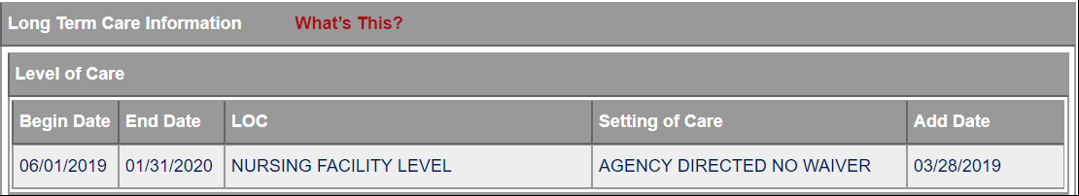
Verify NFLOC
Once you find the Member and enter the service date range, scroll down to section “Long Term Care”.
If the Member has NFLOC, it will be listed under “LOC” (Level of Care). (In this example, the member does have NFLOC).
Look at the “Add Date” to confirm the date of incident occurs on or after the date listed.
NFLOC
40
Notes:
Note: When a Member has either COE 100 or 200, verify if the Member has NURSING FACILITY LEVEL OF CARE.
If yes, use the HSD CIR Portal to report the incident.
If no, do not use the HSD CIR Portal.

Slide 41
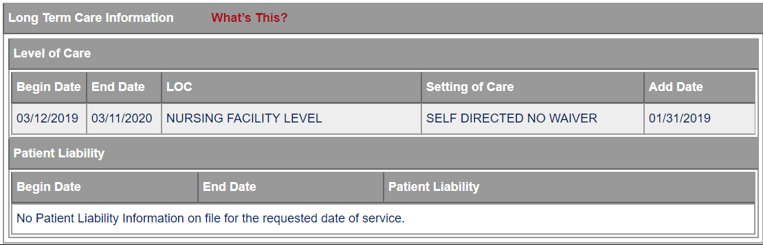

Verify Self-Directed
Once you find the Member and enter the service date, scroll down to section “Long Term Care Information.”
If the Member has a Self-Directed waiver, it will be listed under
“Setting of Care.” (In this example, the member is Self-Directed).
Look at the “Add Date” to confirm the Date of Incident occurs on or after the date listed.
Self-Directed
41
Notes:
Note: If Member has Self Directed Waiver, select YES in the HSD CIR Portal form.
Under setting of care the following options may appear, when these appear the selection should be “No”:
Mi Via
Agency Directed-Please remember that Agency directed is not the same as Self-Directed. The option selected should be No.
Blank

Slide 42

Questions & Discussion
42

Slide 43

HSD Critical Incident Reporting Portal
43

Slide 44
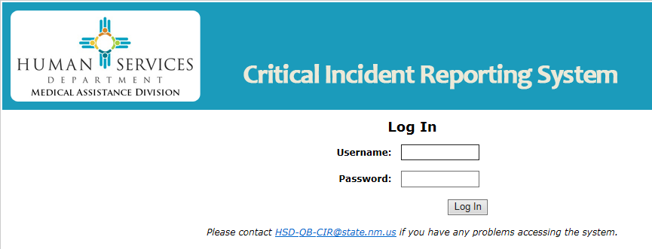
Log In
To submit a Critical Incident Report using the HSD Critical Incident Reporting portal the person in your office who is designated to submit Critical Incident Reports must have an active username and password to log in.
44
Notes:
Reminder: HSD issues and manages all usernames and passwords for the CI Reporting Portal. If assistance is needed with passwords or usernames send an e-mail to HSD-QB-CIR@state.nm.us

Slide 45
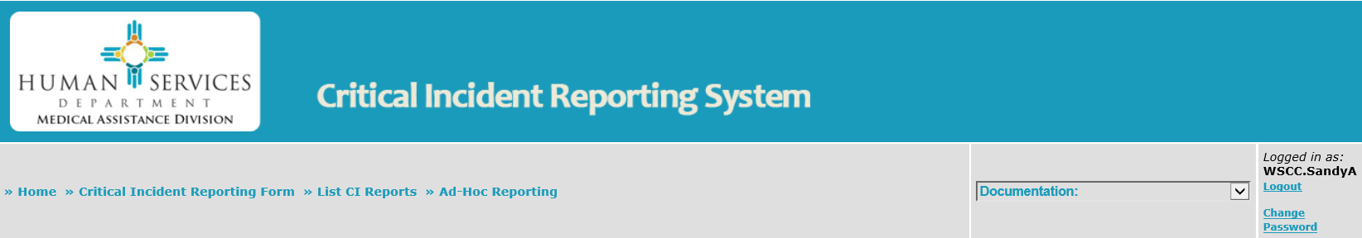
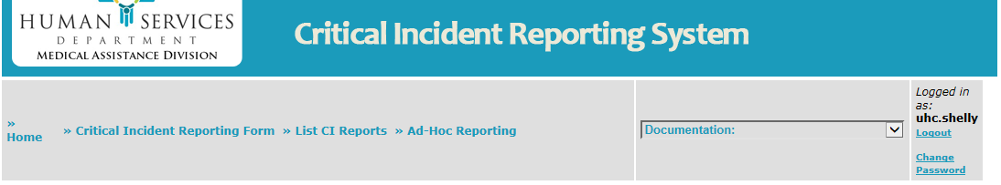

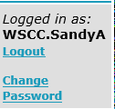

Menu Bar
The Menu Bar is used to navigate through the HSD Portal
45

Slide 46

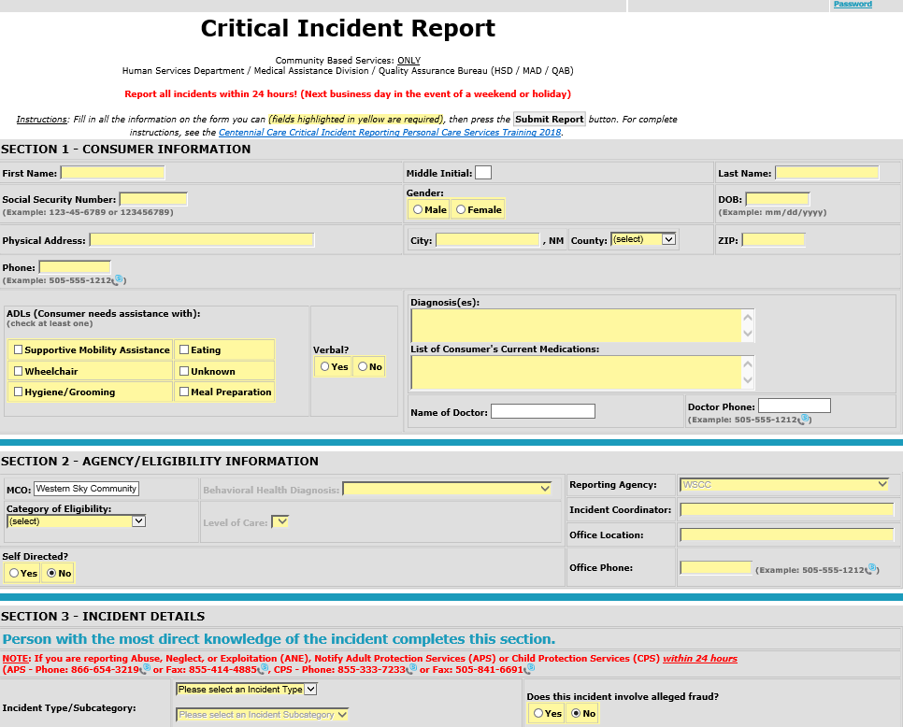
CI Reporting Form
Click on
Critical Incident Reporting Form on the Menu Bar to access the online form.
46

Slide 47
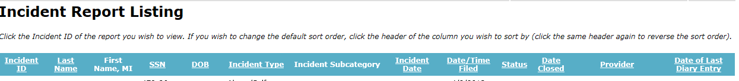
List CI Reports
To get a list of Critical Incident reports submitted by you or your agency click on List CI Reports on the menu bar.
The result will be a listing of Critical Incidents submitted that can be sorted by various factors including name, incident type, date, and more.
47

Slide 48
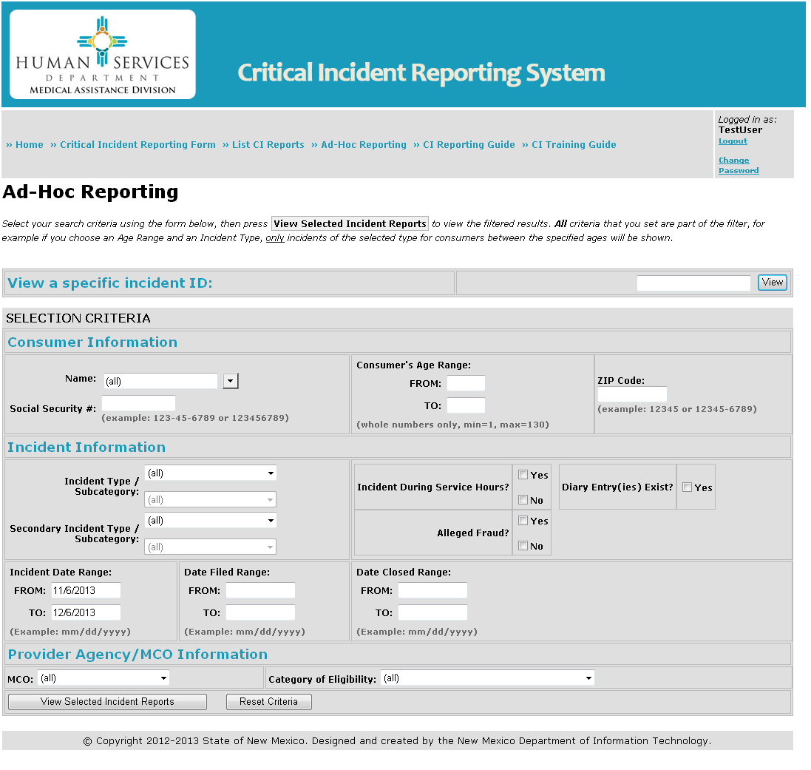

Ad-Hoc Reporting
To view an existing Critical Incident, click on Ad-Hoc Reporting on the menu bar. Specifically, this allows the user to:
Search for a specific Incident using Consumer and or Incident Information.
48

Slide 49
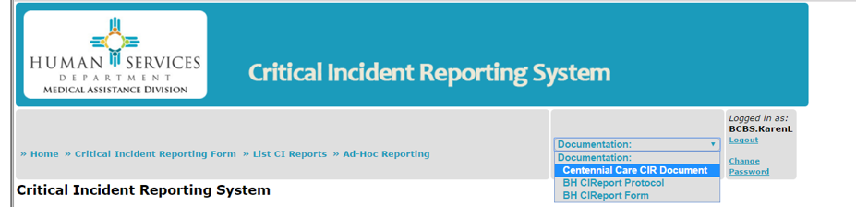
Resources
The “Centennial Care CIR Document” is located under Documentation on the dropdown menu above.
49

Slide 50

Websites & Email
HSD CI Reporting Portal Web Address: https://criticalincident.hsd.state.nm.us
NM Medicaid Portal Web Address:
https://nmmedicaid.portal.conduent.com/static/index.htm
HSD Contact E-Mail Address:
HSD-QB-CIR@state.nm.us
Purpose of HSD E-Mail?
  Request new user access.
  Assistance with usernames and passwords.
  Notify HSD of any employee with Portal access who is no longer associated with organization.
  Report Portal technical issues.
50
Notes:
Submit incident reports for Members of Centennial Care through the HSD Critical Incident Reporting Website.
Once again here is the HSD Portal website: https://criticalincident.hsd.state.nm.us
Remember there is a limited list of accepted COEs.
Incidents must be reported within 24 hours of knowledge of the incident.
Accuracy is important.

Slide 51

Questions & Discussion
51

Slide 52

Submitting a Critical Incident Report
52

Slide 53
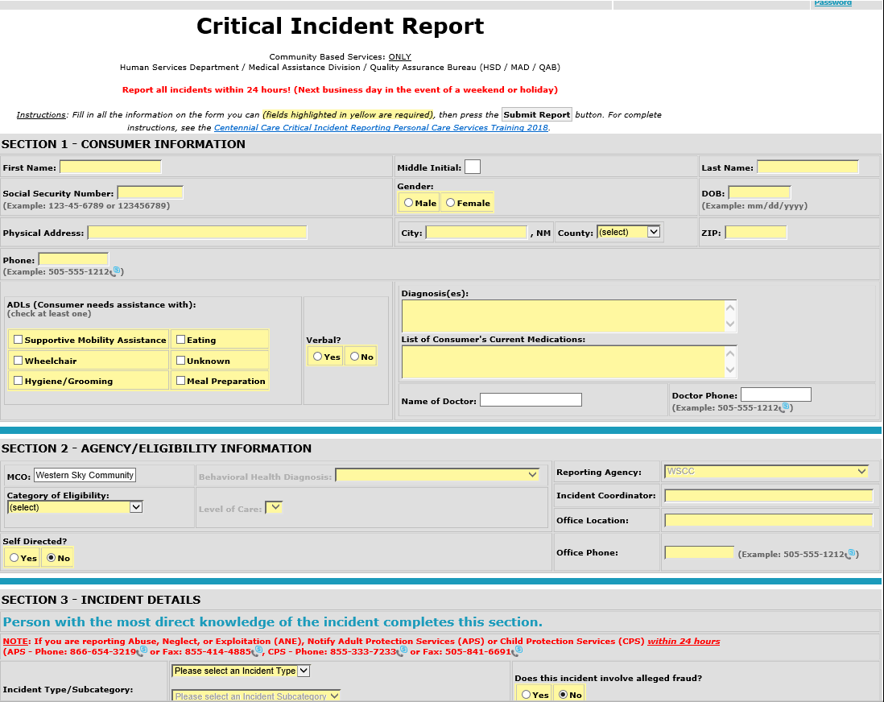
Reporting Form
53
Notes:
In the Critical Incident Report data entry form, the yellow highlighted fields are required and must be completed to successfully submit the form and create an Incident Report number, however, all information is important whether required or not.

Slide 54
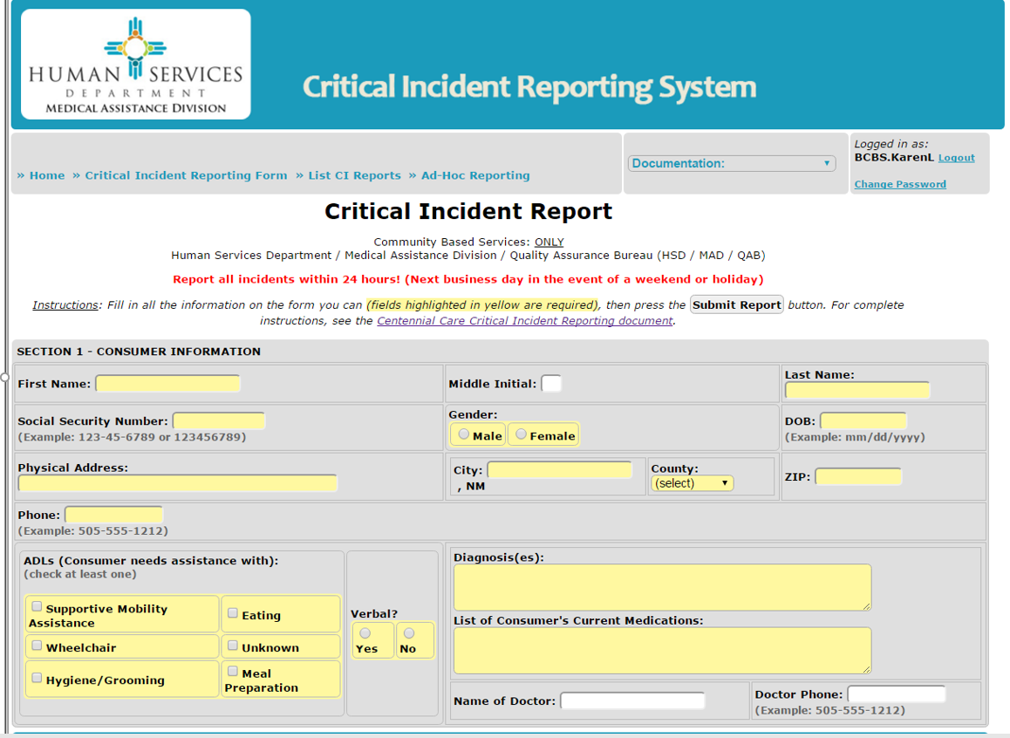
Section 1-Member Information
54
Notes:
Consumer Information:
First Name, Middle Initial, Last Name – Accuracy is important. Correctly spelling the Member’s name will ensure the ability to find and identify the Member.
Social Security Number – Accuracy is important. The agency, the MCO and the State (HSD) track incidents on members for several reasons, including the development of improvement plans. Errors in SSN affects the ability to verify the Member and the validity of the data.
Medicaid ID# can be entered in a Diary Entry if the SSN is not available.
Gender –Select Member’s Gender (Male or Female).
DOB (Date of Birth) – Please be accurate. Incorrect DOB entry affects the ability to accurately identify the member.
Physical Address – The physical address must be entered. Abuse, Neglect, or Exploitation critical incidents are referred out to other state agencies for follow up and they must know where to locate the client.
If the Member is homeless, enter “Homeless” and be prepared to answer a question about the last known address where services were provided. Please inform the service coordinator if any Member is transient or homeless as services may need to be amended.
If the Member does not have an actual physical address, enter the directions on how to find the residence:
Example: “Two miles past the Council House, past the big Cedar tree.”
“Unknown” implies a provider/agency does not know where the person is and raises questions about delivery of services. Be prepared for a phone call requesting more information.
City, County and ZIP – Enter the City, County (from dropdown menu). Use the zip code for the area the Member resides, if unknown, the Zip code can be verified using the Postal Service website: www.usps.com
Phone Number – Enter the Member contact phone number; if none enter “None.”
ADLs – If you do not have the experience with the member or information sufficient to complete this section, please check “unknown” and contact the service coordinator to acquire the information for future reports.
Verbal – Means that the Member can communicate effectively with staff and family. It does not require that they speak. Language preference is not important for this item.
Diagnoses – If this information is available to you, please input it. This is important data to track and this information should be in client records. If agency/provider unable to answer this question, enter “unknown”
Medications – See direction for diagnoses. List no more than three or four. If there are many medications (more than six) state e.g. “10 additional medications.”
Name of Doctor & Doctor Phone – Enter the full name and contact phone number of the doctor.

Slide 55
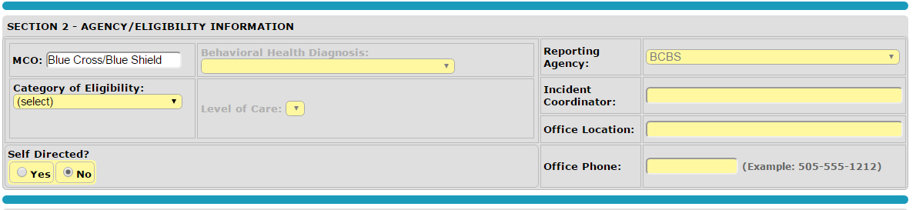
Section 2-Agency/Eligibility Information
55
Notes:
Agency/Eligibility Information:
MCO – Please be accurate. Centennial Care has three (3) participating MCOs. The Critical Incident Report will automatically be reported to the MCO listed in this field. Inaccurate input will affect data validity and possibly violate HIPAA regulations.
Reporting Agency – This field will self-populate with the agency logging in to the site (cannot be changed).
Category of Eligibility (COE) – the COE is available to you upon verification of eligibility. All providers are required to verify recipient eligibility prior to providing services and verify that the recipient remains eligible throughout periods of continued or extended services. Please select the COE from the dropdown menu.
Self-Directed – select Yes or No. This is the Self-Directed Community Benefit (SDCB) that replaced Mi Via as of 01/01/2014. Under setting of care the following options may appear, when these appear the selection should be “No”:
Mi Via
Agency Directed-Please remember that Agency directed is not the same as Self-Directed.
Blank
Incident Coordinator – The name entered here is the name of a person assigned to manage the incident reporting functions of the provider/agency office. Questions about the incident report may go to this person. In the case of various offices for an agency, the agency is to select the staff at the office serving the Member identified in the incident.
Office Location – Please enter the complete physical address of the reporting provider/agency (Address, City, State and Zip Code).
Office Phone – Please provide the full 10-digit phone number, including the area code (example: 505-888-7777) of the reporting provider/agency.

Slide 56
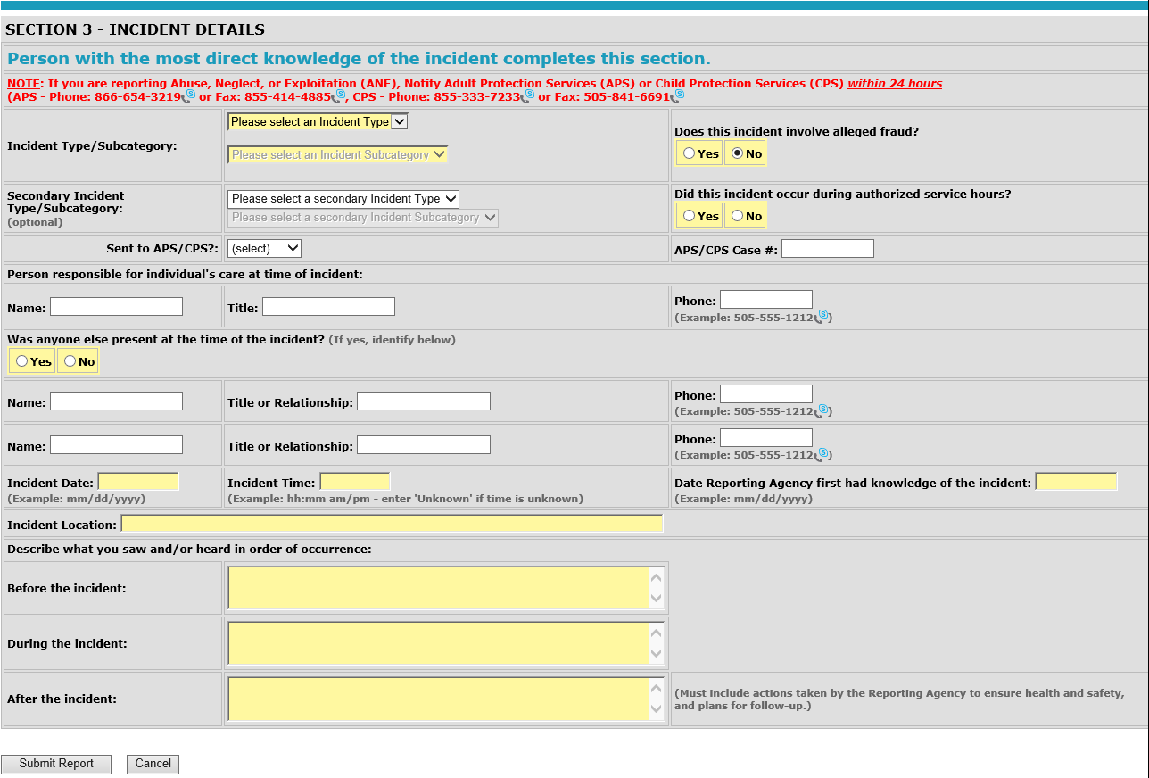
Section 3-Incident
56
Notes:
Incident Details - Person with the most direct knowledge of the incident completes this section
Incident Type/Subcategory – Select the primary Incident from the drop-down menu that most accurately describes the type of incident which has occurred. The incident type is information reported and tracked by several different agencies. Your accuracy helps us to determine what further services may be needed or areas of concern that need to be addressed.
“Emergency Services/Emergency Room with Hospital admit” takes precedence over “Emergency Services/EMT/Fire Dept.- transported to ER.”
Secondary Incident Type/Subcategory (if applicable) – Select the 2nd incident and subcategory from the drop-down menu otherwise leave blank.
Does this incident involve alleged fraud? Select Yes or No.
If there is any reason to believe that fraud has been committed or that waste or abuse of Centennial Care funds are part of the incident, select “yes.” Please provide sufficient information in the description of the incident to support the allegation that fraud may have been committed.
Did this incident occur during authorized service hours? Select yes or no.
Critical incidents must be reported regardless whether or not the incident occurred during service hours.
If the incident happened outside of authorized hours, who was present? Name, title or relationship, phone of who was present during the incident.
Enter the name, title or relationship and phone of the person present at the time of the incident
Person Responsible for the Individual’s care at the time of the incident? Select yes or no if the incident occurred during authorized service hours (meaning a caretaker was present):
Enter the name, title or relationship and phone of the person responsible for care at the time of the incident.
There are two exceptions:
1) The Member is the responsible person, enter “Self” and it is not necessary to enter name and phone.
2) The person that is expected to provide services is a natural support to the Member meaning they are not paid to assist the member and their hours of service provided are not tracked.
If the incident happened outside of authorized hours, who was present? Name, title or relationship, phone of who was present during the incident:
Enter the name, title or relationship and phone of the person present at the time of the incident.
Was anyone else present at the time of the incident? Select Yes or No. If yes, enter the name, title or relationship and phone:
Name, Title or Relationship, Phone – Enter the name, the title or relationship and the phone number of the person(s) who was present at the time of the incident; up to three names can be entered.
Incident Date – A date must be entered. If the reporter does not know the actual date of the incident, enter the 1st day of the month and current year in which the report is being filed. For example: You are filing the report on September 15, but do not know the actual date the incident happened. Enter “09/01/2018” as the date of the incident. Use the narrative section to explain if the actual date is unknown and the “default” date was used.
Incident Time – Enter the time that the incident occurred. If the time is unknown, enter “unknown.”
Date Provider Agency first had knowledge of the incident – Enter the date that the incident was reported to the provider/agency.
Incident Location – Describe where the incident occurred, such as:
Client’s home.
Grocery store.
Doctors office, etc.
Enter exact address if known.
Describe what you saw and/or heard in order of occurrence –There are three incident description boxes, Before, During, and After, all three boxes must be completed.
Five helpful questions to be answered for emergency services in the narrative:
Did they present through the ER and not a planned event?
What did they present for Diagnoses?
At what ER (Pres., UNMH, etc.)?
Who took them (family, EMT, etc.)?
And were they admitted?
There is a 1000-character count limitation per box-This section also called the “Narrative” should be concise and complete. If HSD or the MCO does not understand what happened, the provider/agency will be asked to provide more information.

Slide 57
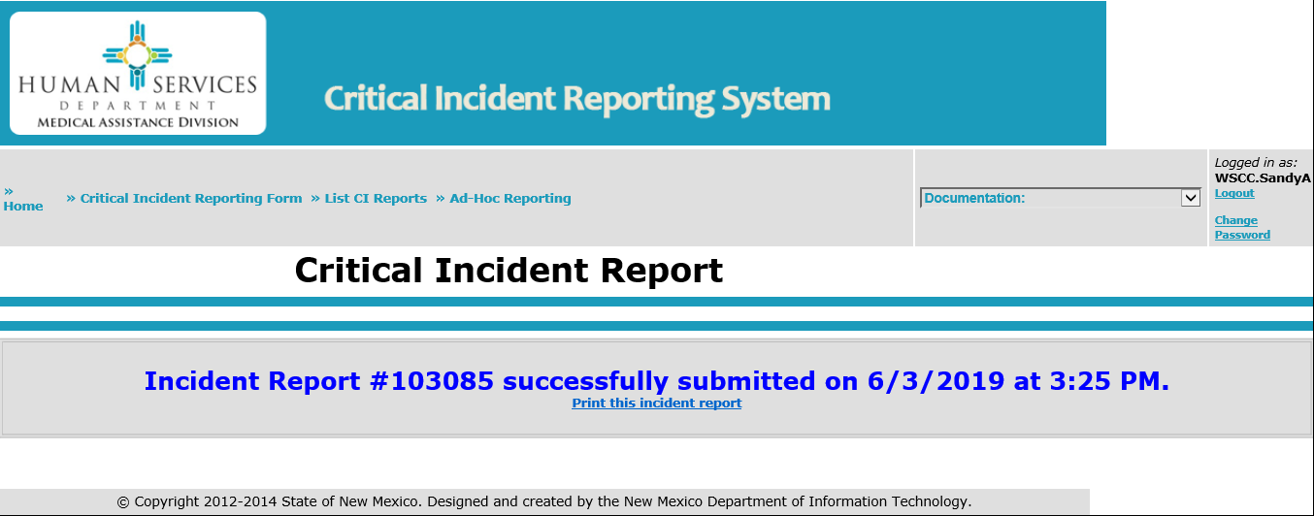
Submission
When the data entry is complete select the button “Submit Report”
one time only and wait … (please do not select this button more than once). Once you select the button there is no going back...
57
Notes:
When a report is submitted successfully, this is what occurs:
The report is transmitted to the database and a date/time stamp is applied.
The report has been assigned a unique number (Report #).
The State (HSD) has access to the report.
The Member’s MCO has access to the report.
The provider/agency has access to the report.
When all required fields are completed, the data entry form will close, a new window will open indicating the report was submitted successfully, generating an Incident Report #.
When all required fields are not completed, the data entry form will remain open showing the required fields in red that need to be completed.

Slide 58
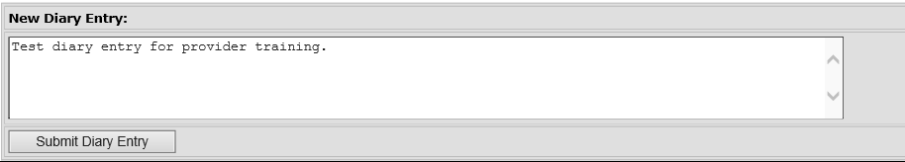
Diary Entries
The “Diary Entry” is a free-text field that is used to enter more information, indicate a correction to the data entry or MCOs to enter updates on the case, etc.
58
Notes:
To create a new Diary Entry:
Click on “Ad-Hoc Reporting”, located on the top menu bar.
Enter the Report # in the “View a specific incident ID” search box.
Select View (the case will appear in a new window).
To view existing diary entries select “Expand All”.
To enter a new diary, click in the white box “New Diary Entry” and type in your information (4000-character limit).
Once you have finished entering in the information, select the “Submit Diary Entry” button (when this happens, the submission date auto populates as well as your log on ID).

Slide 59

Questions & Discussion
59

Slide 60

Online Demonstration
https://criticalincident.hsd.state.nm.us
60

Slide 61

Tips to a Successful
Critical Incident Report
Submit the Report
Be Accurate
Be Comprehensive
Just the Facts
61
Notes:
To help the member, HSD, the support brokers and service coordinators (MCOs) we need to know about any incident(s).
HSD/MCOs make no assumptions about the reports submitted; both HSD and the MCO are reviewing your submissions.
Inaccurate information slows response to the issue and may violate HIPAA regulations.
Have the correct information easily available to the reporter especially if it is not you.
Accuracy and clarity are the keys! Go back and review your submission.
Make sure you have included the names and information needed to tell the story. The diary entries are available for more detailed information or updates.
If it is not documented… it did not happen! (For example, was the incident filed with APS or CPS and noted in the Narrative or Diary?)
Just the facts, (or the allegations). Opinions and information not regarding the event should not be included and may slow down the responsiveness.
Make sure your agency has all the pertinent information and documentation related to any of the follow up activities done by the agency.
In the event a clarification or follow-up is needed on your critical incident report, a member of the Critical Incident staff will reach out to you.

Slide 62
After the report has been submitted successfully…
The critical incident report is reviewed by the MCO and HSD.
The MCO may contact the submitter to clarify information provided on the report.
62
Notes:
The critical incident report is reviewed by the MCO and will verify the following:
Member Demographics (Name, Address, DOB)
Member Category of Eligibility
Agency Information (Contact Name and address)
Incident information
Diary Entries
If any information is missing or incorrect on the report, the MCO will contact the submitter to provide the following:
Updated or additional information about the incident (follow-up activities)
Internal investigation information
Agency documentation (e.g., timesheets, policies and procedures, medical records)
An update on a Critical Incident Report in the diary section of the report on the HSD web portal
To better serve Centennial Care Members, practitioners and agencies should work with the MCO by returning calls, providing responses and updating reports within 24 hours of the MCO request.

Slide 63
Additional information required by the MCOs
Some CIRs will need more specific information with regard to the member’s safety.
For example: CIRs involving abuse, neglect, exploitation and any incident in which the member’s safety is a concern.
The MCO will need information regarding actions taken by the agency and the result of those actions.
A statement will be required on how the member’s health and safety has been addressed and is no longer a concern.
A diary entry should include who is aware of the incident and who is following up on the incident.
63
Notes:
If the MCO is unable to obtain information regarding the member’s safety, they may need to contact the agency more than once until the issue is resolved.
Any follow-up can be entered in the diary entry, however if a new incident has occurred, a separate critical incident report will need to be submitted.
If the report is closed and more information has been obtained, contact the MCO.

Slide 64
MCO Information
Blue Cross Blue Shield of New Mexico | E-mail: BCBSNMCriticalIncident@bcbsnm.com Fax: 505-816-4901 Phone: 1-855-699-0042
Western Sky Community Care | E-mail: NMCI@westernskycommunitycare.com Fax: 833-225-1168 Phone: 505-886-6369 or 505-886-6403
Presbyterian Health Plan | E-Mail: criticalincident@phs.org Fax: 505-843-3011
64

Slide 65

Closing Questions
65

Slide 66

66

