Slide 1


Slide 2

Who can qualify for Mi Via?
People who meet medical and financial eligibility for:
• Developmental Disabilities Waiver
• Medically Fragile Waiver

Slide 3

What does self-direction mean?
In Mi Via, self-direction means …
You have more choices, control and freedom
You decide how to spend the money approved for your use
You decide what services and supports you need
t

Slide 4
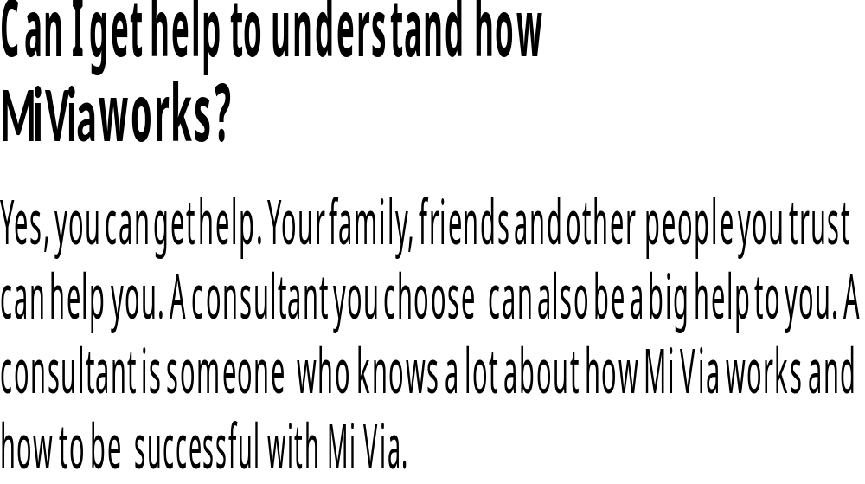

Slide 5

Why did New Mexico decide to offer this program?
People who have disabilities and need help in everyday life said they wanted to be able to have more control over the services they get from the state. New Mexico also wanted to find a better way to serve people with disabilities and use available dollars more wisely.

Slide 6
New Mexico believes that people with disabilities:
• Should have freedom to choose where to live, work and learn
• Should receive services at home and their communities if possible
• Can be trusted to make good decisions
• Can design and direct their plans
• Will obtain the best value for every dollar spent

Slide 7
How is Mi Via different from the traditional waiver programs?
There are five big differences:
1) You can get services and supports that are not available in other Medicaid programs.
2) You will decide what services and supports you need.
3) You will have more freedom and control over your services and supports.
4) You will decide what your workers do and how much to pay them.
5) You can purchase any of the services available under all the existing waiver programs, regardless of your disability and as long as the cost is within your budget.

Slide 8
If I am on a current waiver program, how do I transfer to Mi Via?
When you choose Mi Via, the services you have now will continue until your new plan and budget are approved. Your consultant will help you put together your plan and budget, get them approved and get everything in place to begin Mi Via services.

Slide 9
How can I get the most out of my budget?
You will be able to buy things that cost less or are a better value.
• You won’t have to pay for services you don’t want.
You will direct your own services so you won’t have to spend money on administrative costs.
You can use regular community services to meet your needs, like a health club membership.

Slide 10
With Mi Via, you will have certain responsibilities
Some of your responsibilities are:
• You are in charge of your plan and budget.
• You need to find the people you wish to hire.
• You decide whom to hire and what to pay them.

Slide 11
And, remember, if you need help, it is available. Your consultant can help you. The financial agent can help you. Your family and friends can help you.

Slide 12
You can get the help you need in the way that works best for you. You can also get information written in Spanish and other languages. You can ask to have people help you who speak your language.

Slide 13
So how do I decide which waiver is best for me?
You can receive the most comprehensive information from the Mi Via consultant contractor agency, which can be reached at
1-888-843-2621 OR (505) 204-6035

Slide 14
Other places to get information or help with making your decision include the State web site www.MiViaNM.org

Slide 15
After reviewing all this information, Mi Via is:
o Right for Me
o Not Right for Me
o Still Not Sure

Slide 16


MI VIA: IS IT RIGHT FOR YOU?
For more information about Mi Via, please call:
Toll Free Number: 1(888) 843-2621
Telephone: 505-204-6035
Fax: 505-474-2804
E-mail: sergio@losamigosbs.com
Web: www.losamigosbs.com
www.MiViaNM.org

